Slide 1
Introduction
Chapter 1

Slide 2
The Digital Computer
Machine to carry out instructions
A program
Instructions are simple
Add numbers
Check if a number is zero
Copy data between memory locations
Primitive instructions in machine language

Slide 3
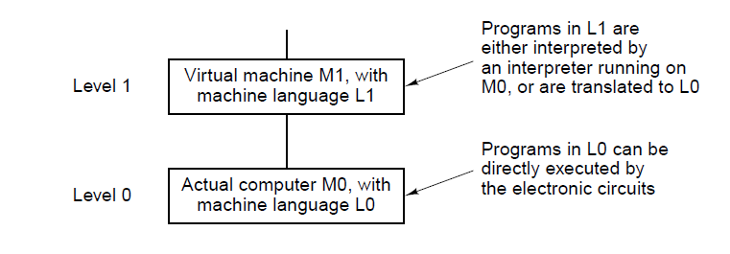
Languages, Levels, and Virtual Machines (1)
. . .

Slide 4
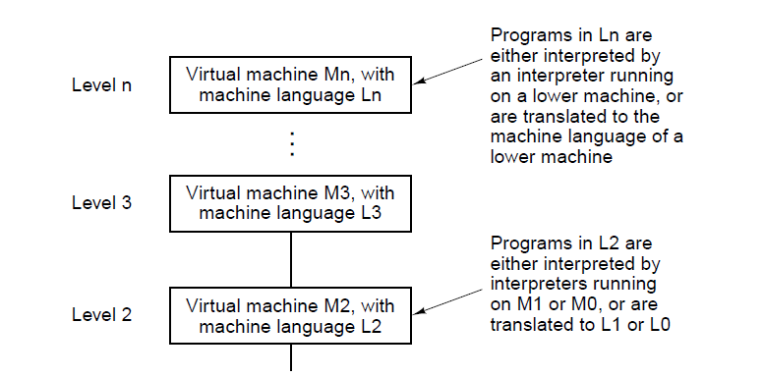
Languages, Levels, and Virtual Machines (2)
Figure 1-1. A multilevel machine.
. . .

Slide 5
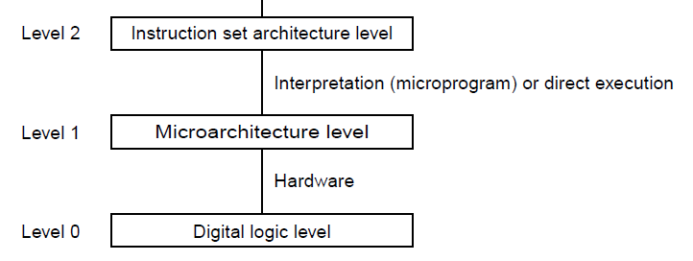
Contemporary Multilevel Machines (1)
. . .

Slide 6
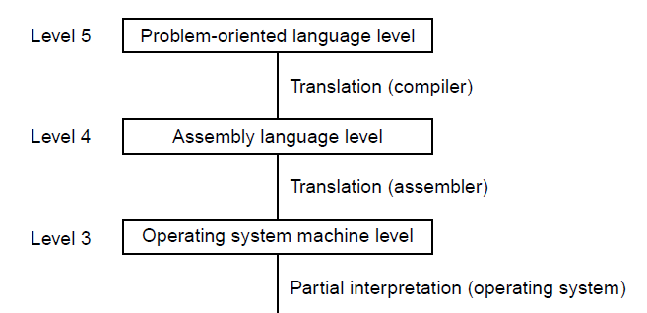
Contemporary Multilevel Machines (2)
. . .

Slide 7
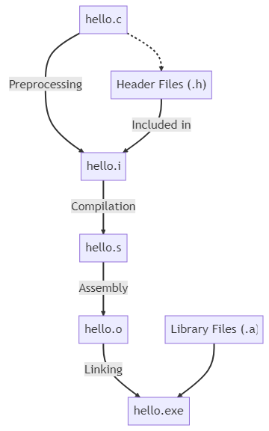
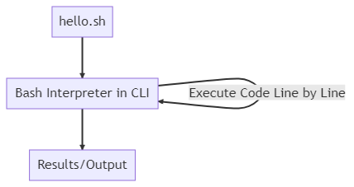
Compiler vs interpreter

Slide 8
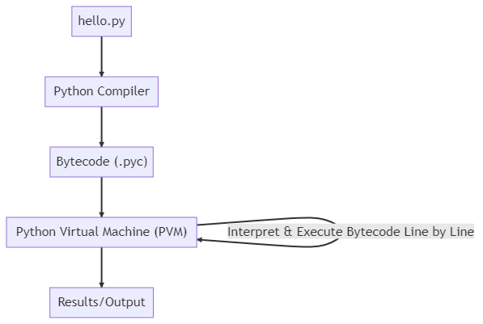
Compilation and interpretation (Java, Python)

Slide 9
Evolution of Multilevel Machines
Invention of microprogramming
increases reliability. (software == hardware)
Invention of operating system
less manual tasks
Migration of functionality to microcode
(software == hardware)
Elimination of microprogramming
(too many software microinstructions => bigger microprogram => less performance)

Slide 10
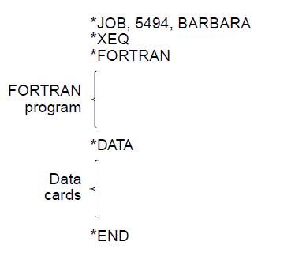
Operating System Tasks

Slide 11
Increased Functionality in Microcode (1)
Instructions for integer multiplication and division
Floating-point arithmetic instructions
Instructions for calling and returning from procedures
Instructions for speeding up looping
Instructions for handling character strings
Indexing and indirect addressing
Relocation facilities
Interrupt systems
Process switching
Processing audio, image, multimedia files

Slide 12
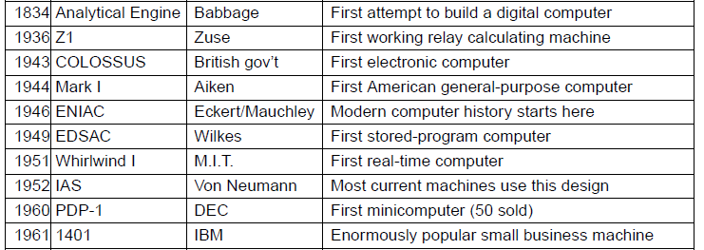
Milestones (1)
. . .

Slide 13
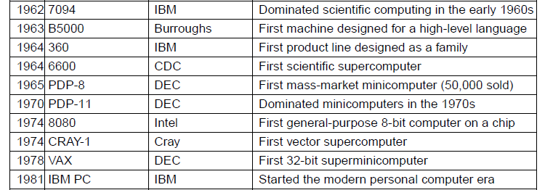
Milestones (2)
. . .

Slide 14
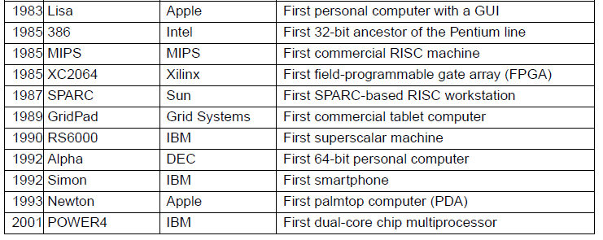
Milestones (3)

Slide 15
Computer Generations
Zeroth Generation Mechanical Computers (1642 – 1945)
First Generation Vacuum Tubes (1945 – 1955)
Second Generation Transistors (1955 – 1965)
Third Generation Integrated Circuits (1965 – 1980)
Fourth Generation Very Large Scale Integration (1980 – ?)
Fifth Generation Low-Power and Invisible Computers

Slide 16
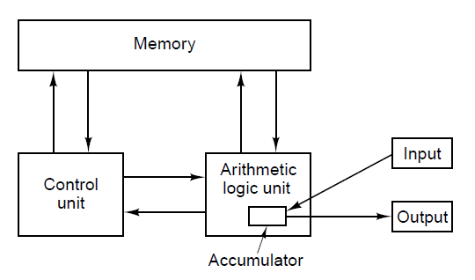
von Neumann Machine (First Generation)
Figure 1-5. The original von Neumann machine.

Slide 17
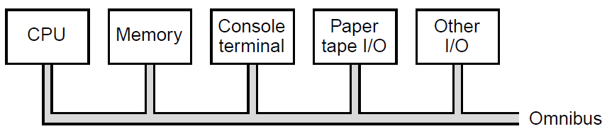
PDP-8 Innovation – Single Bus (Second Generation)

Slide 18
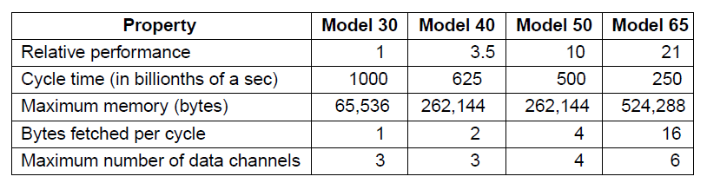
IBM 360 (Third Generation)

Slide 19
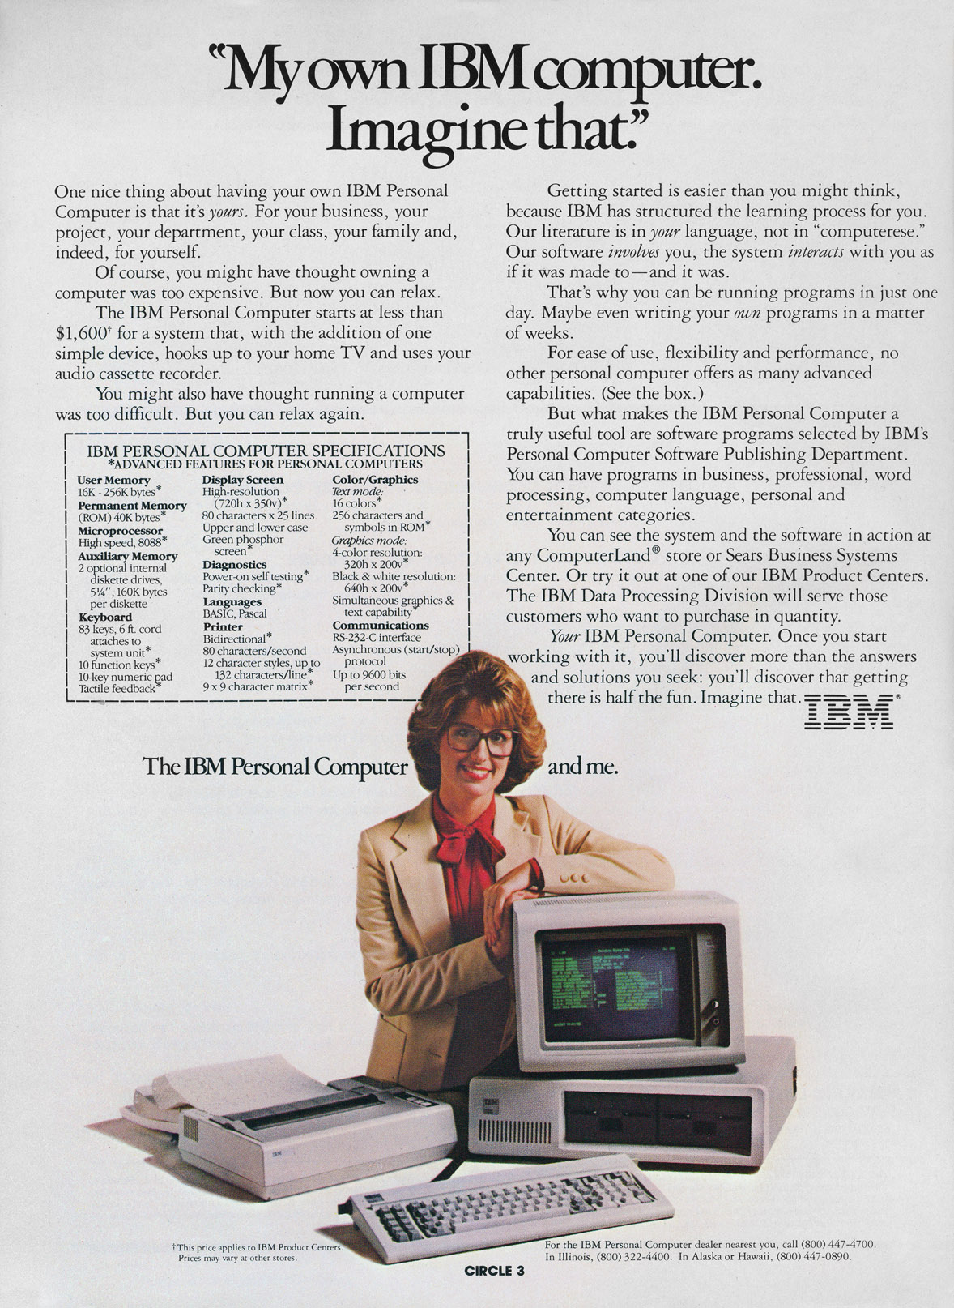

Slide 20
Fifth Generation
Speaking Computers => What? No way!
Invisible Computers => That’s better!
PDA
Smartphone
Cloud computing
AI
…
Quantum Computing (Richard Feynman)

Slide 21
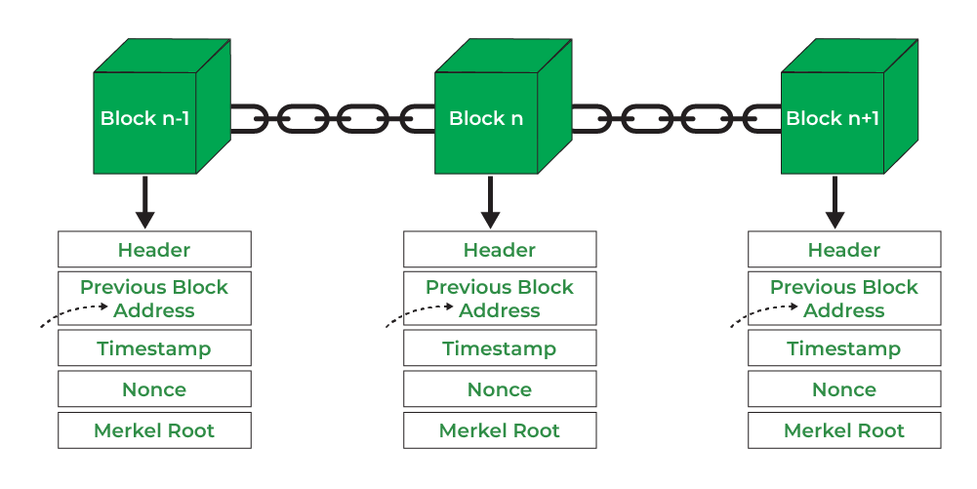
Blockchain Tech
Miner’s task: To add a new block, find a nonce (number) that delivers a SHA-256 hash that provides the difficulty (=most x signifant bits must be equal to zero)
bitcoin strives for a new block every 10 minutes
Too soon
More zero’s
More difficult
Too late
Less zero’s
Less difficult

Slide 22
AI
Why the increase in AI starting in 2023?
ChatGPT (december 2023/january 2024)
Gemini (Google)
Claude (Anthropic/Amazon)
Perplexity
Grok (xAI)
Mistral
Kimi/deepseek/…

Slide 23
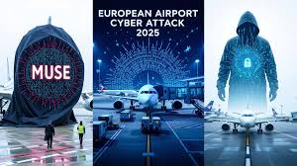
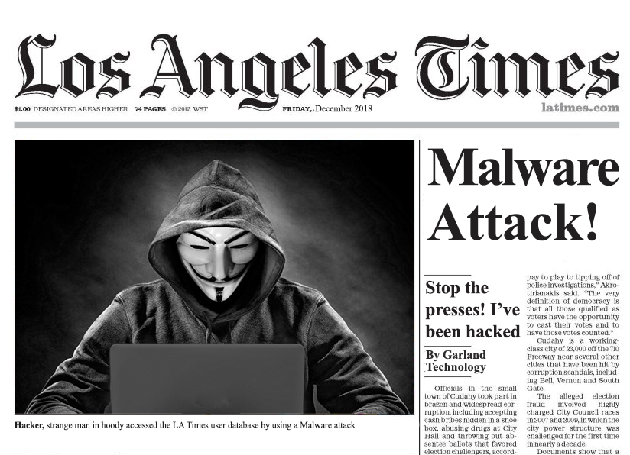
Cybersecurity

Slide 24
Streaming services
Movie production companies came into financial trouble
Revenu in movie theaters went down
Home cinema almost disappeared
Telivision stations stopped broadcasting movies
Netflix (dvd rental company in 1997 )
Netflix (from 2007 streaming service)
During/After corona pandamic
Amazon Prime bought MGM
Disney bought 21st century fox to become Disney+
HBO/Warner was first bought by AT&T to become later Warner Bros-discovery

Slide 25

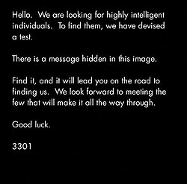

Cicada 3301

Slide 26
Richard Feynman (1918-1988) (sidenote)
Challenger explosion (1986)
Rogers commission
William Rogers (former secretary of state) (chairman)
Neil Armstrong (first man on the moon) (NASA) (vice chairman)
…
…
Richard Feynman (Manhattan project , nobel price winner quantum physics, teacher and maverick …) => Wait wait wait, what is this guy doing here?
“Feynman is becoming a real pain!”
William Rogers to Neil Armstrong

Slide 27
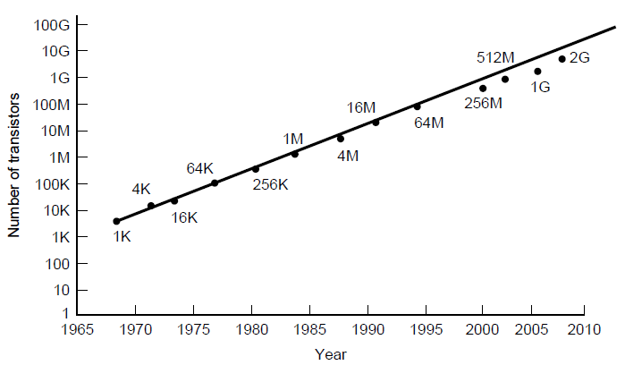
Technological and Economic Forces
Moore’s law predicts a 60 percent annual increase in the number of transistors that can be put on a chip.

Slide 28
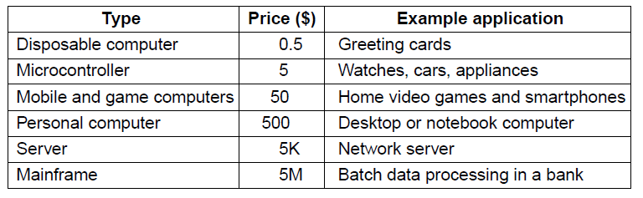
The Computer Spectrum (1)

Slide 29
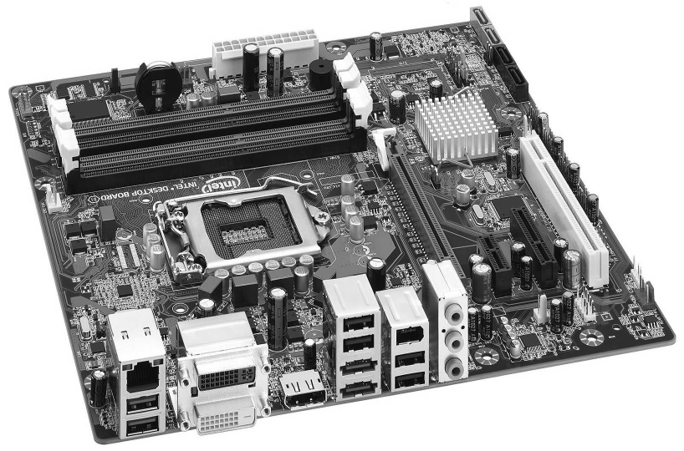
The Computer Spectrum (2)

Slide 30
Microcontrollers
Appliances
Communications gear
Computer peripherals
Entertainment devices
Imaging devices
Medical devices
Military weapon systems
Shopping devices
Toys

Slide 31
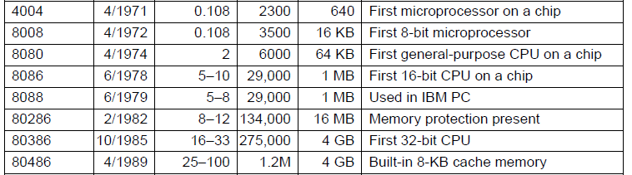
Introduction to the x86 Architecture (1)
. . .

Slide 32
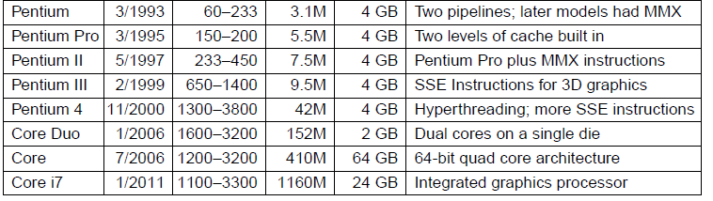
Introduction to the x86 Architecture (2)

Slide 33
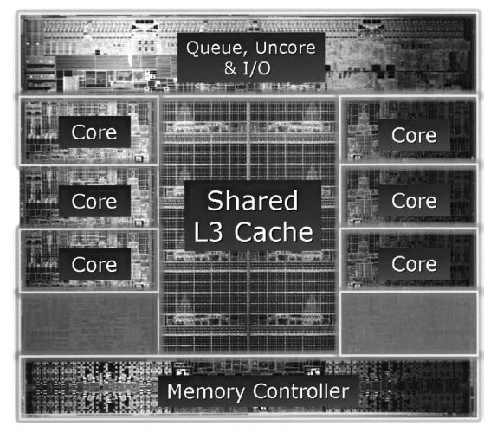
Introduction to the x86 Architecture (3)
The Intel Core i7-3960X die. The die is 21 by 21 mm and has 2.27 billion transistors.

Slide 34
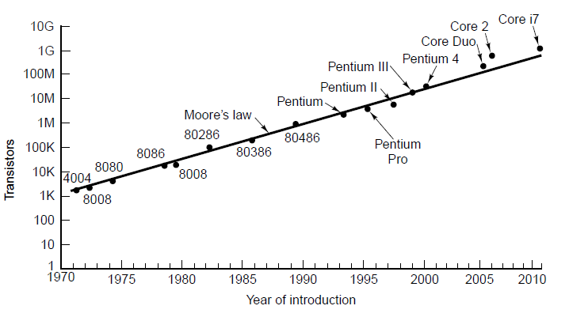
Introduction to the x86 Architecture (4)
Moore’s law for (Intel) CPU chips.

Slide 35
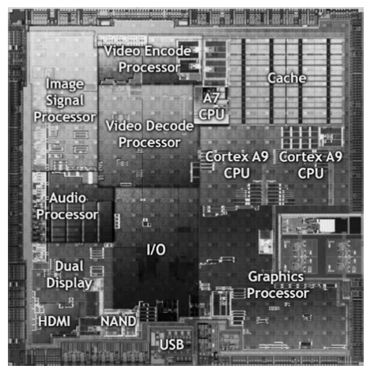
Introduction to the ARM Architecture
The Nvidia Tegra 2 system on a chip.

Slide 36
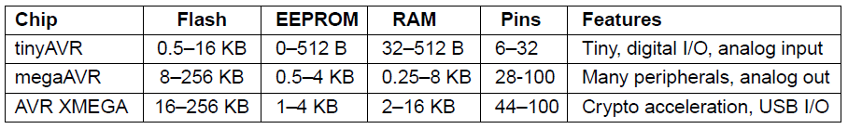
Introduction to the AVR Architecture

Slide 37
Peripherals in the Atmel megaAVR-168
Three timers
Real-time clock with oscillator
Six pulse-width modulation channels
Eight analog-to-digital conversion channels
Universal serial receiver/transmitter
I2C serial interface
Programmable watchdog timer
On-chip analog comparator
Power brown-out detector
Internal programmable clock oscillator

Slide 38
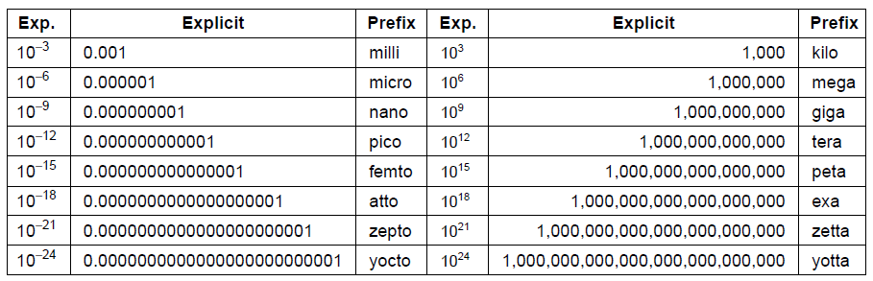
Metric Units
Figure 1-16. The principal metric prefixes.

